Slide 1
Distributed System
by
Mr Alok Tiwari
(CSE Department)
KIET Group of Institutions

Slide 2
Contents
Locks
Optimistic Concurrency control,

Slide 3
Schemes for Concurrency control
Locking
  Server attempts to gain an exclusive ‘lock’ that is about to be used by one of its operations in a transaction.
  Can use different lock types (read/write for example)
  Two-phase locking
Optimistic concurrency control
Time-stamp based concurrency control
Transactions

Slide 4
Transactions T and U with exclusive locks
Transaction
T
:
Transaction
U
:
balance = b.getBalance()
balance = b.getBalance()
b.setBalance(bal*1.1)
b.setBalance(bal*1.1)
a.withdraw(bal/10)
c.withdraw(bal/10)
Operations
Locks
Operations
Locks
openTransaction
bal = b.getBalance()
lock
B
b.setBalance(bal*1.1)
openTransaction
bal = b.getBalance()
waits for
a.withdraw(bal/10)
A
T
’s
lock
lock on
B
closeTransaction
unlock
A
,
B
lock
B
b.setBalance(bal*1.1)
c.withdraw(bal/10)
C
lock
closeTransaction
unlock
B
,
C
Transactions

Slide 5
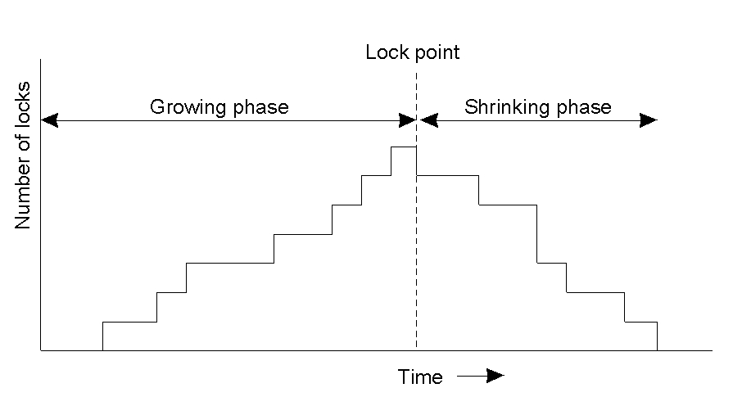
Two-Phase Locking (1)
In two-phase locking, a transaction is not allowed to acquire
any new locks after it has released a lock
Transactions

Slide 6
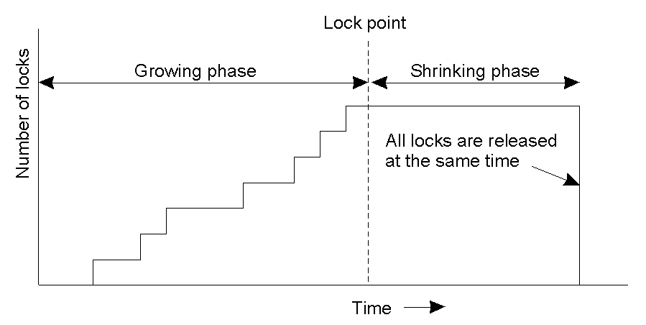
Strict Two-Phase Locking (2)
Strict two-phase locking.
Transactions

Slide 7
Use of locks in strict two-phase locking
1. When an operation accesses an object within a transaction:
  (a) If the object is not already locked, it is locked and the operation proceeds.
  (b) If the object has a conflicting lock set by another transaction, the transaction must wait until it is unlocked.
  (c) If the object has a non-conflicting lock set by another transaction, the lock is shared and the operation proceeds.
  (d) If the object has already been locked in the same transaction, the lock will be promoted if necessary and the operation proceeds. (Where promotion is prevented by a conflicting lock, rule (b) is used.)
2. When a transaction is committed or aborted, the server unlocks all objects it locked for the transaction.
Transactions

Slide 8
Lock compatibility
For one object
Lock requested
read
write
Lock already set
none
OK
OK
read
OK
wait
write
wait
wait
Operation Conflict rules:
1. If a transaction T has already performed a read operation on a
  particular object, then a concurrent transaction U must not write
  that object until T commits or aborts
2. If a transaction T has already performed a read operation on a
  particular object, then a concurrent transaction U must not read
  or write that object until T commits or aborts
Transactions

Slide 9
Deadlock with write locks
Transaction
T
Transaction
U
Operations
Locks
Operations
Locks
write lock
a.deposit(100);
A
write lock
b.deposit(200)
B
b.withdraw(100)
waits for
U
’s
a.withdraw(200);
waits for
T
’s
lock on
B
lock on
A
Transactions

Slide 10
The wait-for graph
Held by
Waits for
A
T
U
T
U
Waits for
B
Held by
Transactions

Slide 11
A cycle in a wait-for graph
U
T
V
Transactions

Slide 12
Another wait-for graph
V
Held by
T
W
T
Held by
Held by
C
U
Held by
B
U
W
V
Waits for
Transactions

Slide 13
Dealing with Deadlock in two-phase locking
Deadlock prevention
  Acquire all needed locks in a single atomic operation
  Acquire locks in a particular order
Deadlock detection
  Keep graph of locks held. Check for cycles periodically or each time an edge is added
  Cycles can be eliminated by aborting transactions
Timeouts
  Aborting transactions when time expires
Transactions

Slide 14
Resolution of deadlock
Transaction T
Transaction U
Operations
Locks
Operations
Locks
a.deposit(100);
write lock
A
b.deposit(200)
write lock
B
b.withdraw(100)
U
a.withdraw(200);
waits for T’s
waits for
’s
lock on
B
lock on
A
(timeout elapses)
T’s lock on
A
becomes vulnerable,
unlock
A
, abort T
a.withdraw(200);
write locks
A
unlock
A
,
B
Transactions

Slide 15
Optimistic Concurrency Control
Drawbacks of locking
  Overhead of lock maintenance
  Deadlocks
  Reduced concurrency
Optimistic Concurrency Control
  In most applications, likelihood of conflicting accesses by concurrent transactions is low
  Transactions proceed as though there are no conflicts
Drawbacks of locking
  Overhead of lock maintenance
  Deadlocks
  Reduced concurrency
Optimistic Concurrency Control
  In most applications, likelihood of conflicting accesses by concurrent transactions is low
  Transactions proceed as though there are no conflicts
Transactions

Slide 16
Optimistic Concurrency Control
Three phases:
  Working Phase – transactions read and write private copies of objects (most recently committed)
  Validation Phase – Once transaction is done, the transaction is validated to establish whether or not its operations on objects conflict with operations of other transactions on the same object. If not conflict, can commit; else some form of conflict resolution is needed and the transaction may abort.
  Update Phase – if commit, private copies are used to make permanent change.
Transactions

Slide 17
Validation of transactions
Working
Validation
Update
T
1
Earlier committed
transactions
T
2
T
3
Transaction
being validated
T
v
active
1
Later active
active
transactions
2
Transactions

Slide 18
Thank
You

